Slide 1
New Jersey Synod
GO AND… A gathering to talk about and explore evangelism and the church today.
“Evangelism is anything you do to help another person move closer to a relationship with God or into Christian community” – Martha Reese

Slide 2
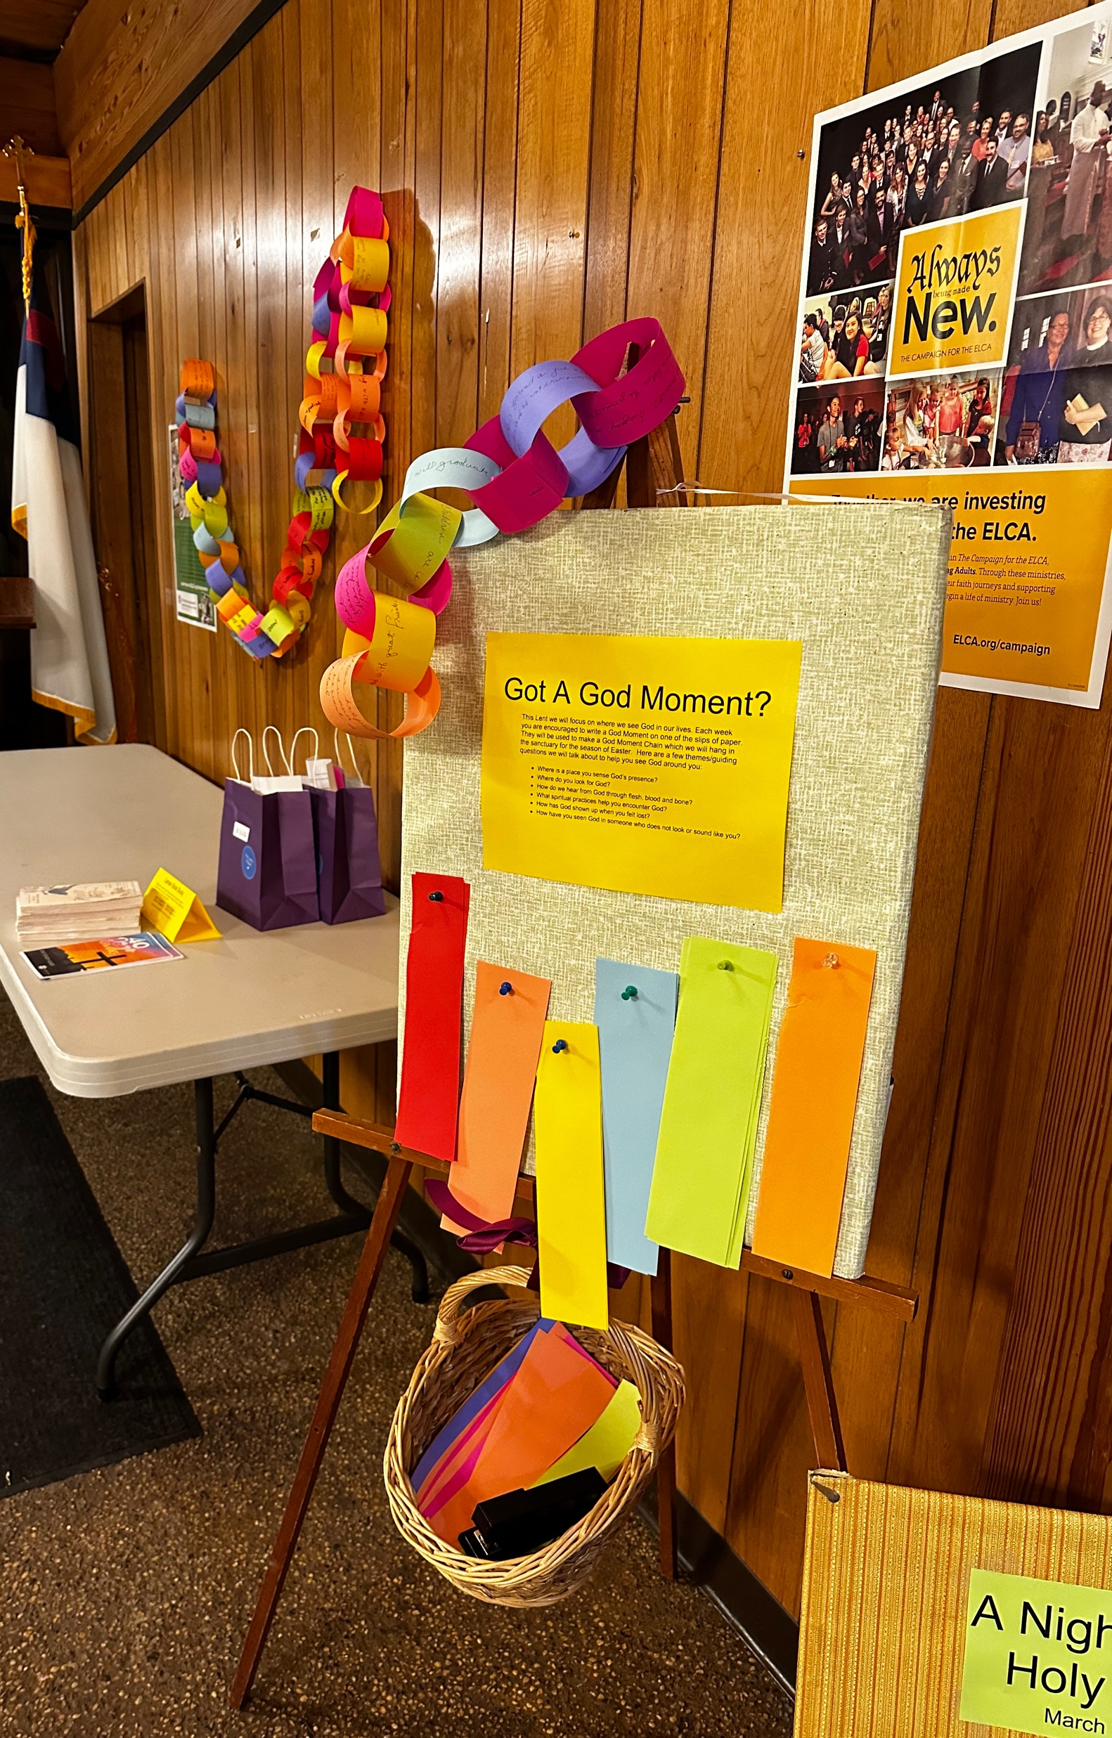
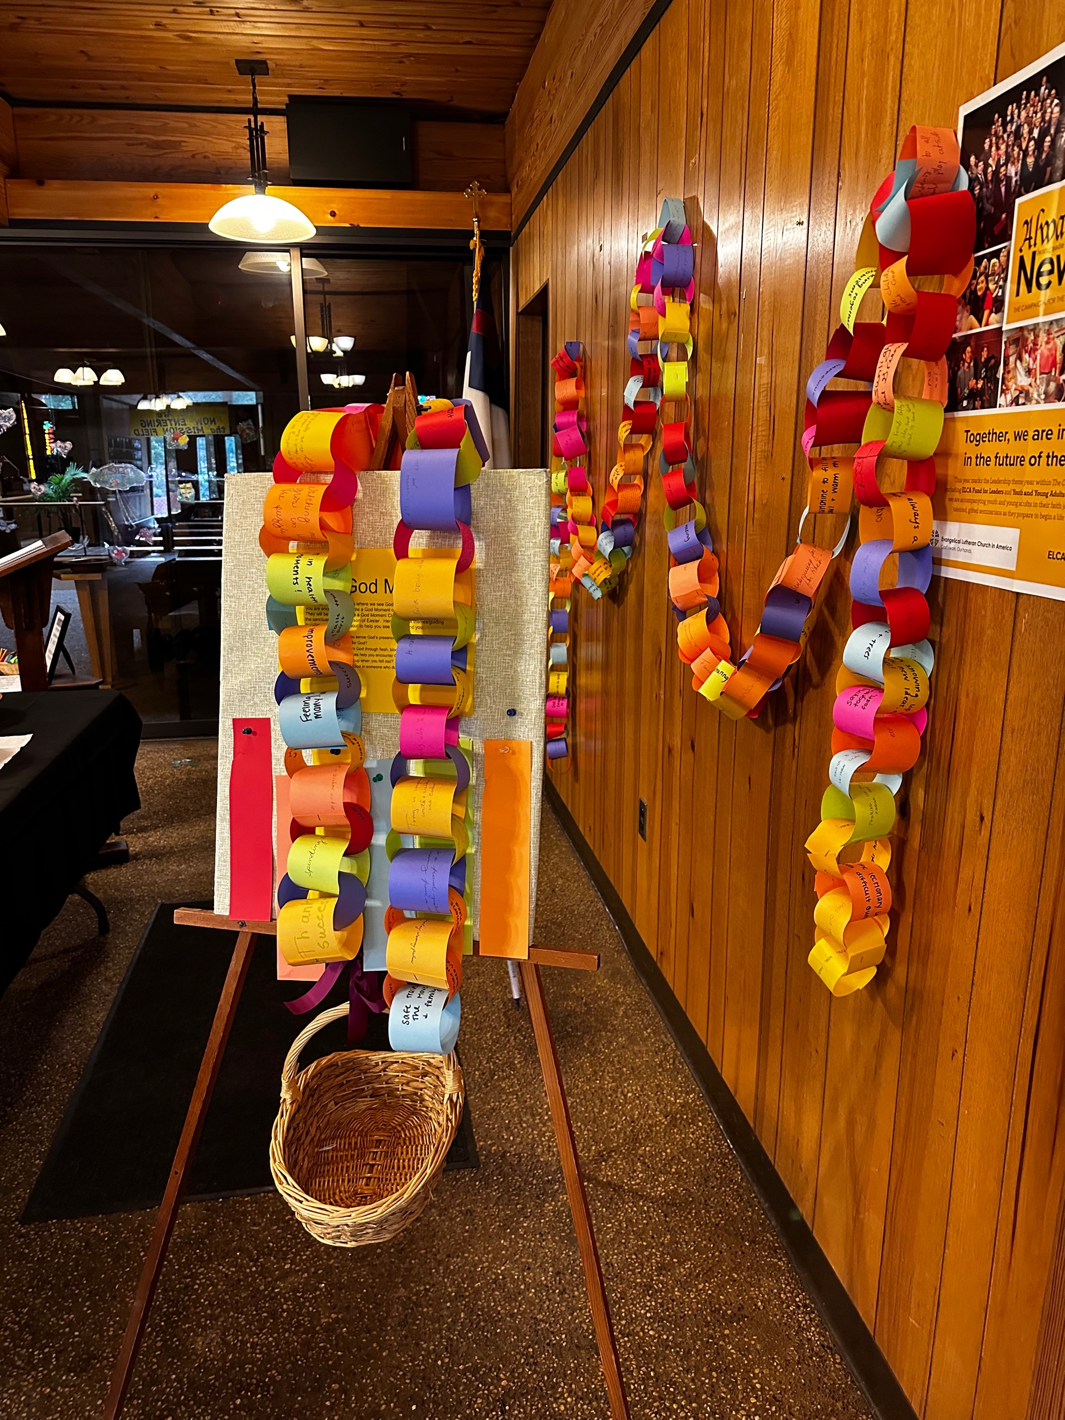
Go And… Share Stories God Moment Chain
Messiah Lutheran - Oakland, NJ

Slide 3
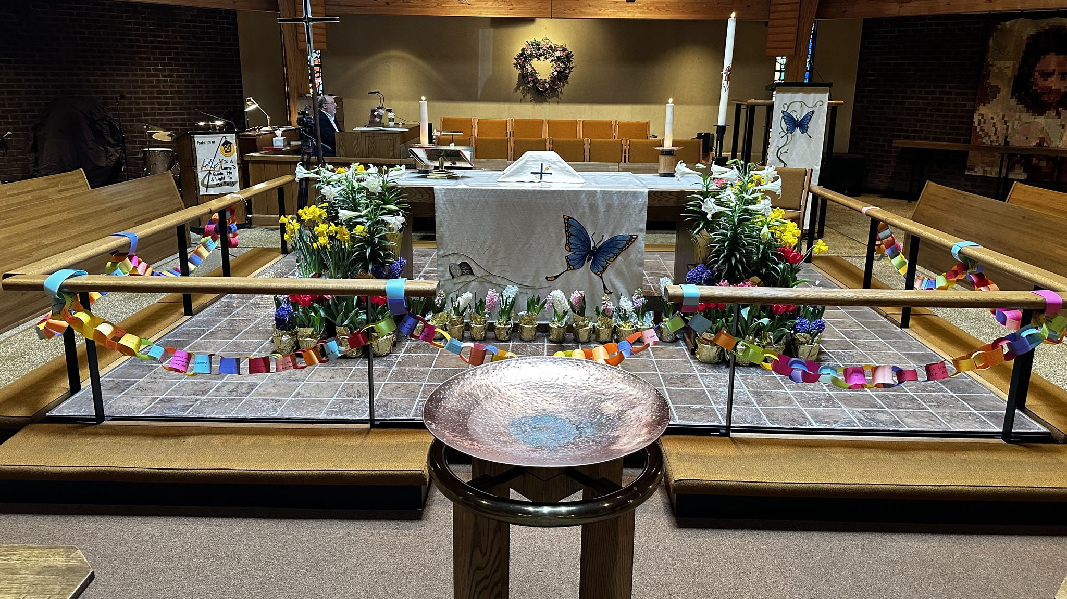
Go And… Share Stories

Slide 4
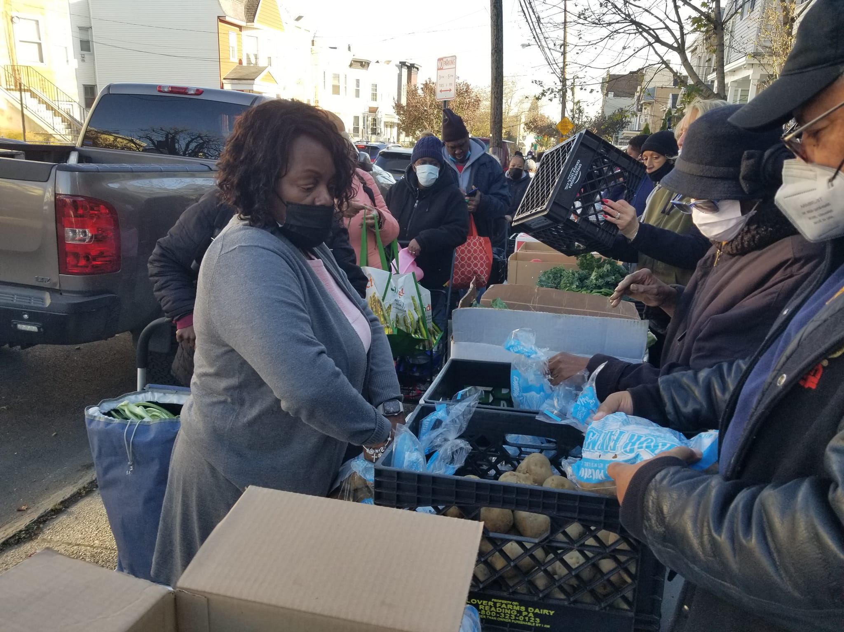
Go And… Share Stories Sacred Moments
Trinity Lutheran – Jersey City, NJ

Slide 5
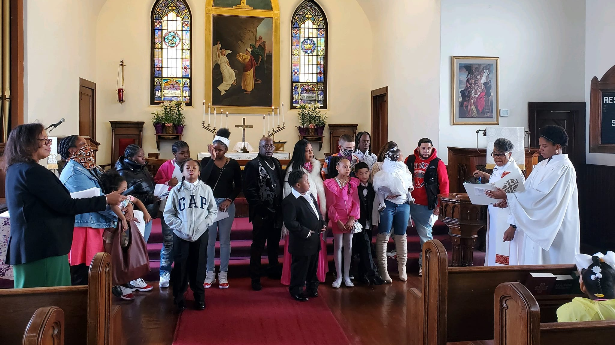
Go And… Share Stories

Slide 6
Table Conversations
Conversaciones de mesa

Slide 7
What caught your attention? ¿Qué te llamó la atención? What did you hear in these stories? ¿Qué escuchaste en estas historias?

Slide 8
Go And… Bless
Blessing of Hands
Look at your hands. Notice their power and gentleness.
Let us bless these hands together.
Blessed be the works of your hands, O Holy One.
Blessed be these hands that have touched life.
Blessed be these hands that have nurtured creativity.
Blessed be these hands that have held pain.
Blessed be these hands that have embraced with passion.
Blessed be these hands that have tended gardens.
Blessed be these hands that have closed in anger.

Slide 9
Go And… Bless
Blessing of Hands
Blessed be these hands that have planted new seeds.
Blessed be these hands that have harvested ripe fields.
Blessed be these hands that have cleaned, washed, mopped, scrubbed.
Blessed be these hands that have become knotty with age.
Blessed be these hands that are wrinkled and scarred from doing justice.
Blessed be these hands that have reached out and been received.
Blessed be these hands that hold the promise of the future.
Blessed be the works of your hands, O Holy One.
Blessing from Sundays and Seasons

