Slide 1
ACTIVE BYSTANDER TRAINING

Slide 2
You have made public profession of your faith. Do you intend to continue in the covenant GOD made with you in holy baptism:
To live among GOD’s faithful people,
To hear the word of GOD and share in the Lord’s supper,
To proclaim the good news of GOD in Christ through word and deed,
To serve all people, following the example of our Lord Jesus,
And to strive for justice and peace in all the earth?
I DO, AND I ASK GOD TO HELP AND GUIDE ME.
-Holy Baptism, Evangelical Lutheran Worship, p. 237
Notes:
This baptismal covenant is our challenge, charge and comfort. This is the WHY behind what we do!

Slide 3
Notes:
New Jersey Synod Core Values: Change, Generosity, Respect, Diversity, Interdependence, Faithfulness

Slide 4
Asian Americans report over 650 racist acts over last week, new data says
-March 26, 2020
Caitlin Yoshiko Kandil
https://www.nbcnews.com/news/asian-america/asian-americans-report-nearly-500-racist-acts-over-last-week-n1169821
Notes:
News reports of an increase in attacks on Asian immigrants and Asian Americans.

Slide 5
NBC's Vicky Nguyen: Coronavirus is spurring anti-Asian attacks—It's time to stick up for those who are targets of racism
March 30, 2020
Vicky Nguyen
https://www.nbcnews.com/know-your-value/feature/nbc-s-vicky-nguyen-coronavirus-capitulating-anti-asian-racism-it-ncna1171926

Slide 6
Video:
Burger King Anti-Bullying Message
https://www.youtube.com/watch?v=mnKPEsbTo9s
Notes:
A simple yet effective demonstration of what bullying looks like.

Slide 7
JESUS’ THIRD WAY
based on Matthew 5
by Walter Wink
Notes:
Wink points out that what we’ve read as a passive approach by Jesus is actually very strong and direct, yet peaceful. (Ex. Roman soldiers often forced people to carry their packs, BUT they were not to make them carry them more than 1 mile. Jesus says, “Make them respect you by carrying it further, therefore forcing them to do the right thing!”

Slide 8
Matthew 5:38-45a
³⁸ “You have heard that it was said, ‘Eye for eye, and tooth for tooth.’ ³⁹ But I tell you, do not resist an evil person. If anyone slaps you on the right cheek, turn to them the other cheek also. ⁴⁰ And if anyone wants to sue you and take your shirt, hand over your coat as well. ⁴¹ If anyone forces you to go one mile, go with them two miles. ⁴² Give to the one who asks you, and do not turn away from the one who wants to borrow from you.
⁴³ “You have heard that it was said, ‘Love your neighbor and hate your enemy.’ ⁴⁴ But I tell you, love your enemies and pray for those who persecute you, ⁴⁵ that you may be children of your Father in heaven.
Notes:
Not a position of aggression or weakness, but one of strength.

Slide 9
FLIGHT | FIGHT
Submission | Armed revolt
Passivity | Violent rebellion
Withdrawal | Direct retaliation
Surrender | Revenge
Notes:
The 2 ways we’ve been taught that are the human instinctive responses to fear or conflict – either give in or fight.

Slide 10
Jesus’ Third Way
Seize the moral initiative
Take control of the power dynamic
Find a creative alternative to violence
Make the “powers” make decisions for which they are not prepared
Assert your own humanity and dignity as a person
Recognize your own power
Meet force with ridicule or humor
Shame the oppressor into repentance
Notes:
Wink, Walter, “The Powers That Be: Theology For a New Millennium”, 1998, pp. 98-111.

Slide 11
Jesus’ Third Way
Break the cycle of humiliation
Be willing to suffer rather than retaliate
Refuse to submit or accept the inferior position
Force the oppressor to see you in a new light
Expose the injustice of the system
Deprive the oppressor of a situation where a show of force is effective
Be willing to undergo the penalty of breaking unjust laws
Die to fear of the old order and its rules
Notes:
Wink, Walter, “The Powers That Be: Theology For a New Millennium”, 1998, pp. 98-111.

Slide 12
What is an Active Bystander?
-Every day we witness many things (both good and not so good). This makes us all bystanders.
-We also make decisions about how to respond to what we see. Our choices can turn us into active bystanders.
-An active bystander witnesses an act that is harmful (such as name-calling, derogatory joke-telling, rumors, property damage or physical violence) or potentially harmful and doesn’t just observe passively or walk away.

Slide 13
AN ACTIVE BYSTANDER DOES SOMETHING ABOUT IT!

Slide 14
Active Bystander Training in Response to School Bullying:
Experts on anti-bullying programs have observed that “Positive rapport and relationships between teachers and students must be established for bystander intervention participants to successfully intervene on behalf of victims.”
“Students who have been identified as leaders to intervene may be the most efficient and successful means to increase bystander interventions.”
Teach safe schools:
http://www.teachsafeschools.org/bully_menu5-2.html
Notes:
School districts began teaching students to be “upstanders” to address alarming rates of suicides and school violence due to bullying.

Slide 15
Active Bystander Training on College and University Campuses:
“Sexual assault and relationship abuse impact many people on college campuses. Nationally, it’s estimated that 1 in 5 women will be sexually assaulted in their lifetimes and that they are most vulnerable between the ages of 16 and 24. College aged men and women also experience relationship abuse at high rates.”
-University of New Hampshire
https://www.unh.edu/sharp/bystander
Notes:
Colleges and universities began teaching active bystander training to help students to intervene to reduce sexual attacks on campuses.

Slide 16
Bystander Anti-Racism:
Action taken by a person or persons (not directly involved as a target or perpetrator) to speak out about or to seek to engage others in responding (either directly or indirectly, immediately or at a later time) against interpersonal or systemic racism
Notes:
Bystander Anti-Racism is in response to attacks on people based on race, as well as religion and residency status.

Slide 17
What Does The Bible Say?
Exodus 1:15-2:10 – Pharaoh orders all the Hebrew boy babies to be killed, but Moses is hidden and is saved by Pharaoh’s daughter.
Exodus 22:21 – Moses gives God’s law: “You shall not wrong or oppress a resident alien; for you were aliens in the land of Egypt.”

Slide 18
Leviticus 19:33-34 and 24:22 – When the alien resides with you in your land, you shall not oppress the alien. The alien who resides with you shall be to you as the citizen among you; you shall love the alien as yourself, for you were aliens in the land of Egypt: I am the Lord your God.”
Isaiah 16:4 – Be a refuge to the outcasts of Moab.
Jeremiah 7:5-7 – “If you do not oppress the alien…then I will dwell with you in this place…”

Slide 19
Jeremiah 22:3-5 – Do no wrong or violence to the alien.
Zechariah 7:8-10 – Do no oppress the alien.
Malachi 3:5 – The messenger will bear witness against those who thrust aside the alien.

Slide 20
Matthew 2:13-15 – Jesus and parents flee Herod’s search for the child.
Matthew 5:10-11 –“Blessed are those who are persecuted.”
Matthew 25:31-46 – “…I was a stranger and you welcomed me.”
Luke 4:16-21 – “…Bring good news to the poor…release to the captives…sight to the blind...let the oppressed go free.”

Slide 21
Hebrews 13:1-2 – “…show hospitality to strangers, for by doing that some have entertained angels…”
I John 3:18 – “…Let us love, not in word or speech, but in truth and action.”
I John 4:7-21 – “Beloved, let us love one another, because love is from God…” We love because God first loved us.”

Slide 22
What Does The Quran Say?
Surah 24: 22 - And let not those of virtue among you and wealth swear not to give [aid] to their relatives and the needy and the emigrants for the cause of Allah, and let them pardon and overlook. Would you not like that Allah should forgive you? And Allah is Forgiving and Merciful.

Slide 23
Why do we intervene?
Taking action early – before a situation escalates – can be effective and safer for everyone involved.
The bystander effect, or bystander apathy, is a social psychological phenomenon that refers to cases in which individuals do not offer any means of help to a victim when other people are present. The greater the number of bystanders, the lesser the chance of intervention.

Slide 24
When we …
stay silent
do nothing
look the other way
say, “It’s none of my business”
think, “someone else will deal with it”
… we support hurtful behavior and unequal treatment.
…we participate in a system that allows violence, discrimination and suffering.

Slide 25
When we take action, we …
make a positive impact on the people experiencing harm and on those committing a harmful act.
help give others the confidence to speak up or act.
contribute to creating a community where people care about and help each other.
improve our own lives by supporting a culture that values healthy relationships and offers help when needed.

Slide 26
TEDtalk:
Clint Smith and The Danger of Silence
https://www.ted.com/talks/clint_smith_the_danger_of_silence

Slide 27
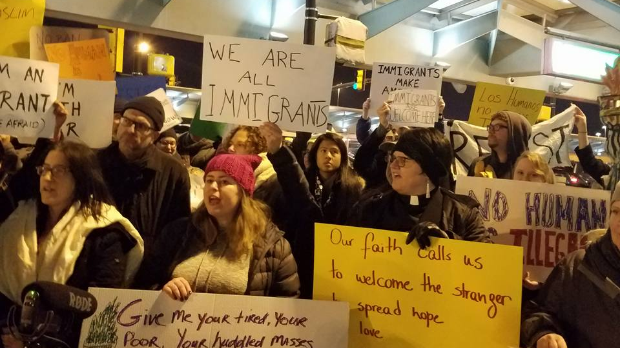
Notes:
New Jersey residents at Newark Airport, after the January 2017 travel ban was announced. In front, Rev. Maristela Freiberg.

Slide 28
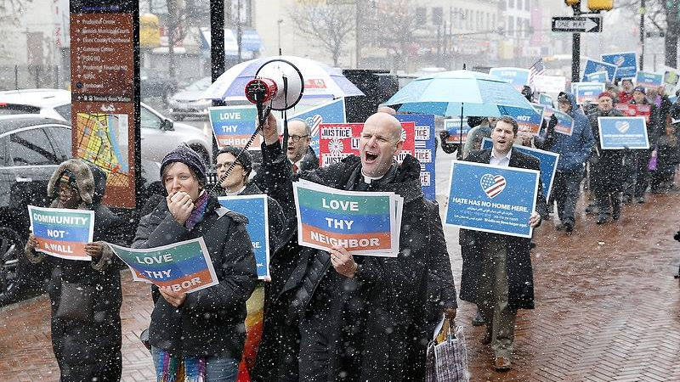
Notes:
Union/Essex County (NJ) clergy marching to protest scheduled deportation of a man. Rev. Kathryn Irwin in front.

Slide 29
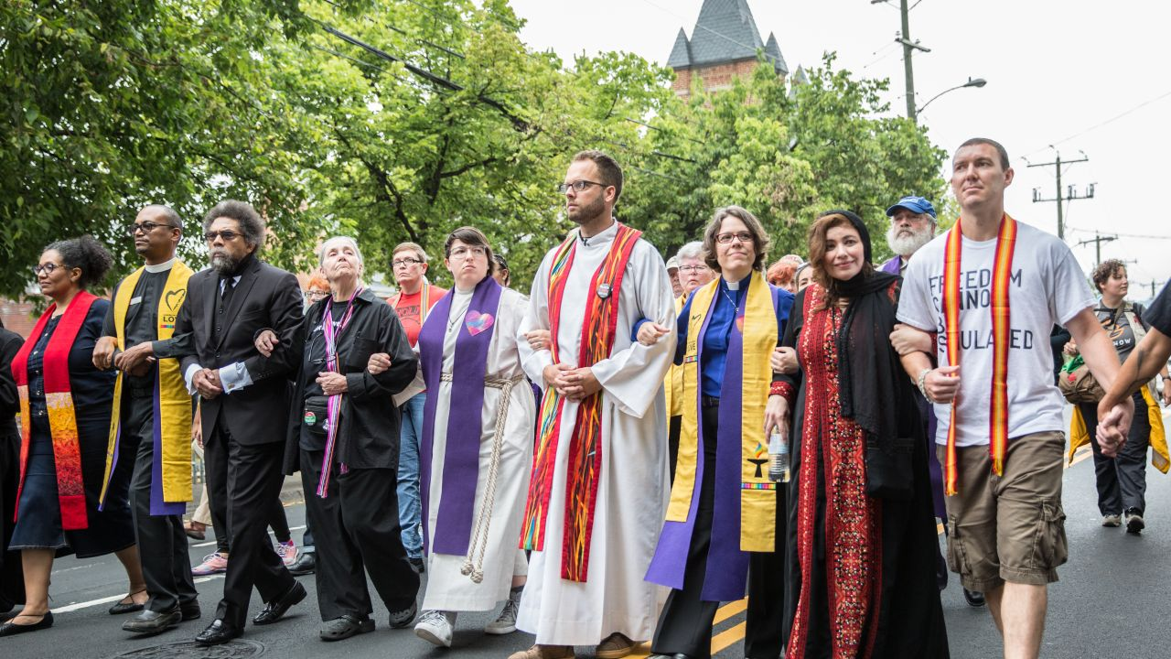
Notes:
Multi-faith silent march in Charlottesville, VA during white supremacist gathering, 2017.

Slide 30
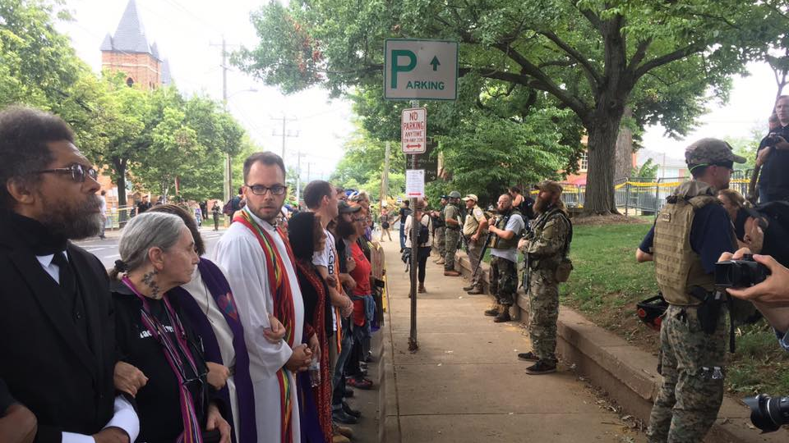
Notes:
Multi-faith clergy in Charlottesville, VA. Note: Men in military gear are not military but members of white supremacist militia groups.

Slide 31
The 4 “D’s” of Active Bystandership
DIRECT
DISTRACT
DELEGATE
DOCUMENT
Notes:
Note: Each person’s comfort level is different. Find which strategy feels best for you!

Slide 32
DIRECT
Step in and interrupt a harmful situation by pointing out the problem and engaging participants in conversation about better alternatives.
Say things like:
“That’s not funny!”
“Wow! I’m surprised to hear you say something like that!” “What you said [or did] isn’t very respectful.” “That type of language [or behavior] isn’t OK.”

Slide 33
DIRECT
Ask: “Is this person bothering you?” “Is there anything I can do to help?”
Stand next to someone so they know they are not alone.
Look disapprovingly at a person who is harassing someone else.
Don’t join in or laugh.
Tell someone (then or later) why you what they did or said was hurtful.
If a person is mistreated, tell them it wasn’t okay and you’re sorry it happened.

Slide 34
DISTRACT
If you aren’t comfortable calling out the problematic behavior, try interrupting a risky situation by distracting and redirecting the people involved.
Ask an unrelated question about a class assignment, a TV show or even the weather. The goal is simply to change the subject!
Tell them you think someone is looking for them.
Ask them to show you where the bathroom is.
Say something positive (like, “Hey, nice shirt!”) to anyone involved.

Slide 35
DELEGATE
If you can’t do it alone, involve others.
Attract “allies in action.” (Call attention to the situation and get others to help you speak up, prevent or interrupt.)
Tell a staff person right away (a manager or owner if possible).
Seek out appropriate resources.
In an emergency, always call 911.

Slide 36
DOCUMENT
Use your camera and/or voice recorder to record the incident.
Do not make yourself a victim! Keep a safe distance but close enough to capture clear video and sound, and only if it is safe.
You do not need to engage those involved. It can make the situation worse by increasing aggression.
Do not post videos or photos on social media without the permission of a victim. Doing so can cause as much harm as – or more than – the initial incident.
In some cases, a clear video or recording can assist authorities in their investigation.
Notes:
USE DISCRETION WITH DOCUMENTING: Keep yourself safe. Do NOT post online without victim’s permission. Law enforcement may ask for your video/photos.

Slide 37
Strategies in the Moment
Name or acknowledge an offense
Point to the "elephant in the room“
Interrupt the behavior
Publicly support an aggrieved person
Use body language to show disapproval
Use humor (with care)
Encourage dialogue
Help calm strong feelings
Call for help

Slide 38
Strategies After the Fact
Privately support an upset person. Listen supportively
Talk privately with the inappropriate actor
Report the incident, with or without names
Provide information about resources available to the aggrieved person

Slide 39
Example
A church member expresses concern about new visitors of a different race, implying that “those people” make her feel unsafe.
Response: Remind the woman that all are welcome at church. Unless someone has harmed or threatened harm, then they are to be left alone.
Response: State publicly to the congregation that bigotry is not permitted at this church. Ask congregation to commit to this.

Slide 40
Example
A council member makes a racist joke at a meeting.
-Response: “That kind of humor is not acceptable here. That’s offensive.” -Response: “Ouch!”
-Response: frown, clear your throat, wide-eyed surprised look.
-Response: get up and walk out.

Slide 41
Example
You see a couple walking behind an Asian couple, verbally harassing them, threatening them. They have small children with them.
Response: (to the children) “Hi there! Are you having fun? Did you see [point to something interesting nearby]? Isn’t that cool?”
Response: (to the harassers) “You need to stop right now. I’ve called the police.”
Response: Quietly record as much as you can, following at a safe distance.

Slide 42
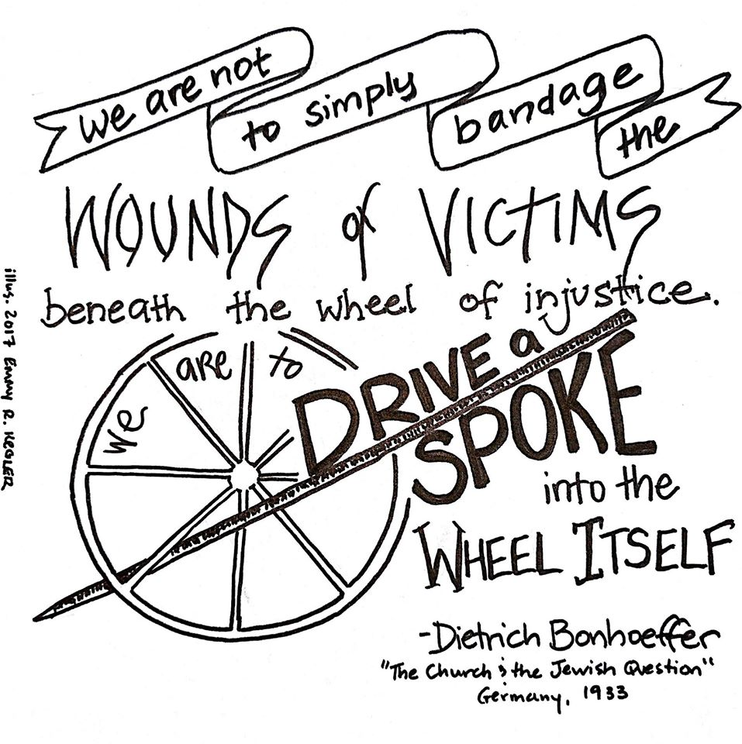

Slide 43
RESOURCES
American Broadcasting Company. What Would You Do? video series. © Disney. All rights reserved. Available: http://abc.go.com/shows/what-would-you-do
Berkowitz, Alan – Videos on Being An Active Bystander. Available: http://www.alanberkowitz.com/videos.php
Dunn, Kevin, Nelson, Jacqueline, et al. Review of bystander approaches in support of preventing race-based discrimination. 2010. Available: file:///C:/Users/Owner/AppData/Local/Temp/Bystander_discrim_review.pdf

Slide 44
RESOURCES
Francis, Leah G. Ferguson & Faith: Sparking Leadership & Awakening Community. St. Louis: Chalice Press. 2015.
Gentile, Mary C. – Giving Voice To Your Values: How To Speak Your Mind When You Know What’s Right. Available: http://www.givingvoicetovaluesthebook.com/resources-for-educators/
Keneally, Thomas. Schindler’s List. Touchstone: New York. 1982

Slide 45
RESOURCES
Massachusetts Institute of Technology. Active Bystanders. Available: http://web.mit.edu/bystanders/index.html
#RighteousResistance. Clergy Anti-Racism Preparedness Toolkit. http://thisisworr.org/wp-content/multiverso-files/1_5992181908ac4/CLERGY-ANTI-RACISM-PREPAREDNESS-TOOLKIT.FINAL_.pdf
Southern Poverty Law Center. Speaking Up: Responding To Everyday Bigotry. Available: https://www.splcenter.org/20150126/speak-responding-everyday-bigotry#casual
Smith, Clint, TEDtalk: The Danger of Silence. Available: https://www.ted.com/talks/clint_smith_the_danger_of_silence

Slide 46
RESOURCES
University of Massachusetts. Be An Active Bystander. Available: https://www.umass.edu/umatter/be-active-bystander
U.S. Department of Justice, Civil Rights Division, Educational Opportunities Section. Available: https://www.justice.gov/crt/educational-opportunities-section
Western University of Sydney. Bystander Anti-Racism Project. Available: https://www.youtube.com/watch?v=zR3ojs2C2j4

Slide 47
FOR YOUTH GROUPS:
Burger King Corporation. Anti-Bullying video. TM & © 2017 Burger King Corporation. All rights reserved. Available: https://www.youtube.com/watch?v=mnKPEsbTo9s
NoBully.org (Anti-bullying education materials) Available: https://www.nobully.org/
The Ophelia Project. Practicing Interventions: Role Playing. 2012. Available: http://www.opheliaproject.org/teaching/Role%20Playing%20Packet.pdf
Southern Poverty Law Center. Teaching Tolerance (resources for educators). Available: http://www.tolerance.org/

