Slide 1
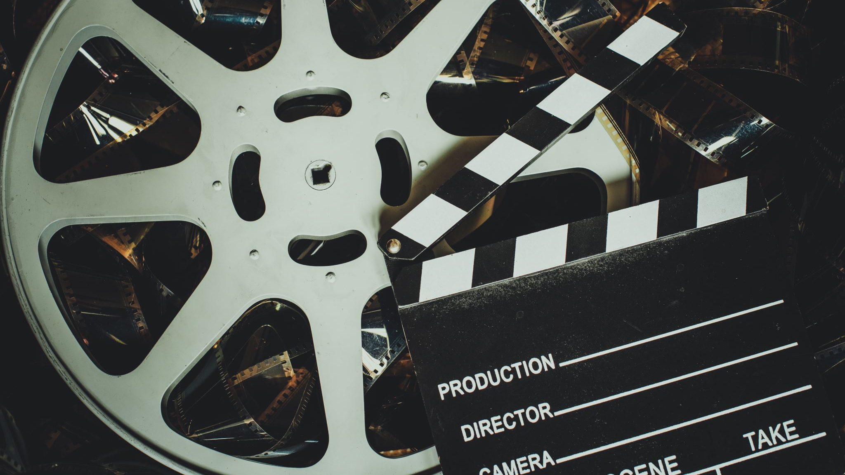
FILMS ON RACISM

Slide 2
12 Years A Slave (2013) Regency Enterprises. Rated R.
13th (2017 Netflix) Kandoo Films by Ava DuVernay. Rated TV-MA.
42. (2013) Warner Bros. Rated PG-13.
Always in Season. (2019). Multimedia Films. No Rating.
American History X (Film about recruitment into white supremacist groups. Caution: graphic violence). New Line Cinema. 1998. Rated R.
American Son. (2019) Netflix. Rated TV-MA.
Amistad. (1997) DreamWorks. Rated R.
The Autobiography of Miss Jane Pittman. (1974). Tomorrow Entertainment. Rated TV-PG.

Slide 3
Bamboozled. (2000) 40 Acres & a Mule. Rated R.
Black Panther. (2018) Marvel Studios. Walt Disney Pictures. Rated PG-13.
BlacKkKlansman. (2018) Focus Features. Rated R.
Blindspotting. (2018) Liongate. Rated R.
The Bronze Screen: 100 Years of the Latino Image in American Cinema (2002). Questar. No Rating.
Bury My Heart at Wounded Knee. (2007). HBO Films. Rated TV-14.
Clemency. (2019). ACE Pictures Entertainment. Rated R.
Crash (2004) Yari Film Group. Rated R.

Slide 4
Crime + Punishment. (2018) Hulu. No Rating.
Cry Freedom. (1987) Universal Pictures. Rated PG.
Cry, The Beloved Country. (1951) London Film Productions. No Rating.
A Day Without a Mexican. (2004) by Sergio Arau. Rated R.
Detroit. (2017). First Light Production. Rated R.
Do The Right Thing. (1989) 40 Acres and A Mule Filmworks. Rated R.
DreamKeeper. (2003) Hallmark Entertainment. No Rating.
Fences. (2016) BRON Studios. Rated PG-13.

Slide 5
Free State of Jones. (2016). Route One Entertainment. Rated R.
Fruitvale Station (2013) by Significant Productions OG Project. Rated R
Get On The Bus (1996) 40 Acres and a Mule. Rated R.
Ghosts of Mississippi. (1996) Castle Rock Entertainment. Rated PG-13
Glory. (1989). TriStar Pictures. Rated R.
Guess Who's Coming To Dinner. (1967). Columbia Pictures. Not Rated.
Harriet. (2019). Martin Chase Productions; New Balloon; Perfect World Pictures; Stay Gold Features. Rated PG-13.

Slide 6
The Hate U Give. (2018). Fox 2000 Pictures. Rated PG-13.
Hidden Figures. (2016). Fox 2000 Pictures. Rated PG.
I Am Not Your Negro (2017) by Raoul Peck. Rated PG-13.
If Beale Street Could Talk (2018) Annapurna Pictures. Rated R.
Imitation of Life. (1934). Universal Pictures. Not Rated.
Imitation of Life. (1959). Universal International Pictures. Not Rated.
Just Mercy. (2019). Warner Brothers. Rated PG-13.
Let the Fire Burn. (2013) Amigo Media. No Rating.
Loving. (2016) Raindog Films. Rated PG-13.
Mississippi Burning. (1988) Orion Pictures. Rated R.

Slide 7
Mudbound. (2017). Armory Films. Rated R.
My Family. (1995) American Playhouse. Rated R.
Queen & Slim. (2019). BRON Studios. Rated R.
Rabbit-Proof Fence. (2002) Rumbalara Films. Rated PG.
A Raisin in the Sun. (1961). Columbia Pictures.
Roots. (1977). David L. Wolper Productions. Rated TV-14.
Selma (2014) by Ava DuVernay. Plan B Entertainment. Rated PG-13.
Seven Seconds. (2019). Netflix. Rated TV-MA.
Skins. (2003). First Look International. Rated R.

Slide 8
Smoke Signals. (1998) ShadowCatcher Entertainment. Rated PG-13.
Snow Falling on Cedars (1999) Kennedy/Marshall. Rated PG-13.
Sorry to Bother You. (2018). Cinereach. Rated R.
This May Be The Last Time. (2014). This Land Films. No Rating.
To Kill A Mockingbird (1962) Brentwood Productions.
A United Kingdom. (2016) Fox Searchlight Pictures. Rated PG-13.
When They See Us. By Ava DuVernay. (2019) Netflix. Rated TV-MA.
Whose Streets? (2017). Magnolia Pictures. Rated R.

