Slide 1
New Jersey Synod Evangelical Lutheran Church in America
THE NEW JERSEY SYNOD
2015
SPENDING PLAN
Notes:
SUE
Good morning. My name is Pastor Sue Jones from Lord of Life Church in Tabernacle. I serve as the Chair of the Fiscal Management and Property Committee in the New Jersey Synod. This presentation of the 2015 budget will anchor our financial plan in the mission and structure of our work in the New Jersey Synod. Tomorrow you will vote on the specific dollars and cents of the budget, today we want to hear the stories and open discussion related to the gathering and allocation of resources in this Synod that are essential to the joyful implementation of God’s work with our hands on 2015.

Slide 2
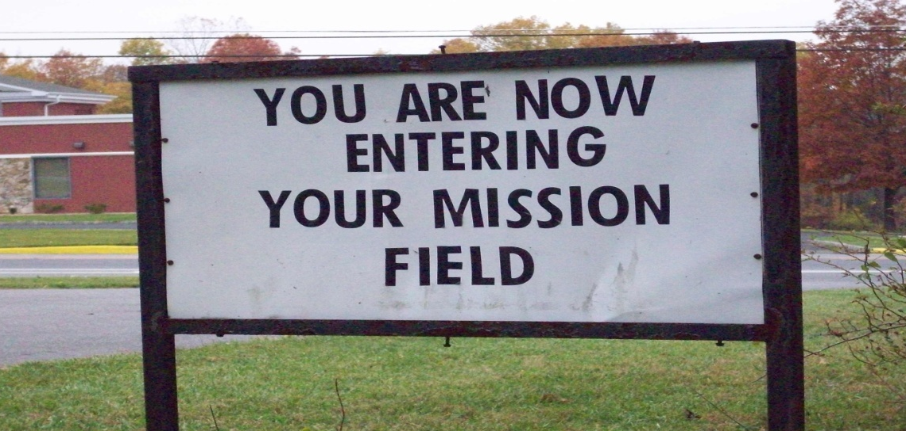
A Missional Synod
We understand ourselves as “a people created by God in Christ, empowered by the Holy Spirit, called and sent to bear witness to God’s creative, redeeming, and sanctifying activity in the world.” (ELCA Constitution for Synods)
Exiting Church property at St. Luke, Washington
Notes:
SUE
I invite you to turn your eyes and ears to this presentation which outlines our plan to generously use our shared assets for God’s mission.
Strengthening our participation in God’s work remains our top priority. We understand ourselves as “a people created by God in Christ, empowered by the Holy Spirit, called and sent to bear witness to God’s creative, redeeming, and sanctifying activity in the world.”

Slide 3
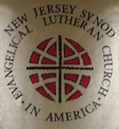
Essential, Enduring, Core Values
This is who we are together.
People of:
Faithfulness
Respect
Diversity
Generosity
Change
Interdependence
Notes:
SUE
The New Jersey Synod is a visionary synod . This proposed spending plan is determined to challenge our imagination and strengthen the ways we live into our mission.
Our proposals embrace our core values of:
Faithfulness
Respect
Diversity
Generosity
Change
Interdependence
These qualities are the bedrock upon which we make our decisions. These are the values captured in our financial plans. These essentials shape our gathering, discernment, and decisions today.

Slide 4
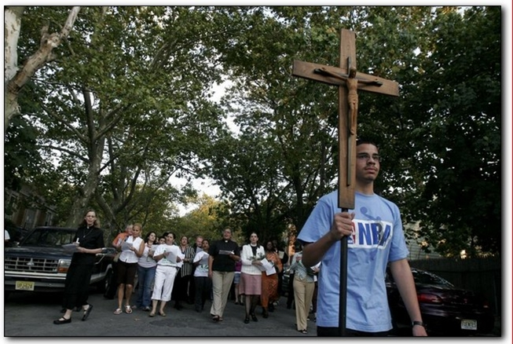
Because You Care
The mission momentum created in this Synod through your generosity is cause for thanksgiving and celebration.
The faithfulness of God’s people in New Jersey has not wavered in the face of changing context and challenges.
THANK YOU!
Salting the world with hope and life in Camden, NJ
Notes:
SCOTT
I am Pastor Scott Schantzenbach, Assistant to the Bishop for Stewardship and Faith Formation. The most critical resources in the New Jersey Synod are the congregations of God’s people who serve as mission outposts on our territory. By growing strong congregations, by cultivating faith filled disciples, we not only fulfill the great commission but we enlighten, leaven, salt and flavor the neighborhoods in which we live.
I want to thank you for remaining grounded in faith in Jesus Christ
I want to thank you for being bold and undaunted in your commitment and work
I want to thank you for remaining generous in tumultuous times, and for generously supporting God’s work through the work of your hands and the bounty of your gifts.

Slide 5
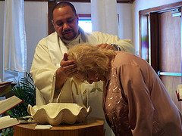
The Spending Plan is a Mission Document
Directs resources into critical missional areas so that the church will exercise faithful behaviors:
ELCA Churchwide and Ministry Partners
Strengthening Congregations
Outreach Supporting Congregations
Office of the Bishop Supporting Mission and Ministry
Oversight and Planning for the Sake of Mission
Living the Great Commission
Notes:
SCOTT
The work that we are engaged in today is critical to the Evangelical Mission of this church. The spending plan that will be adopted at this Assembly is one of the most important mission documents in any expression of this church.
The 2015 Spending Plan has a bold new look. Today we unveil the 5 spending categories that embrace a clear statement about what is good and important in this synod.
These 5 spending categories include:
ELCA Churchwide and Ministry Partners
Strengthening Congregations
Outreach Supporting Congregations
Office of the Bishop Supporting Mission and Ministry
Oversight and Planning for the Sake of Mission
Behind each of these spending categories are the critical missional areas and behaviors that strengthen ministry and enact God’s work.

Slide 6
A New and Simple Look to the 2015 Spending Plan
Captures our Mission Focus.
Allocates resources, staff, and program to grow our capacity to support congregations.
Reflects an emerging interdependence among the Lutherans in New Jersey
Notes:
MARCIA
I am Marcia Craig from Holy Trinity in Red bank. I find excitement in this spending plan. This is the first spending plan prepared by Bishop Bartholomew and the current Synod Council. The 5 clear and concise spending categories capture the mission focus of the New Jersey Synod.
Attentiveness to growing the capacity for witness among our congregations is Job #1. We are allocating resources, staff, and programs directly to the venues where they can be most effective.
Let’s take a look at some of the foundational pieces of our mission plan.

Slide 7
New Jersey Synod 2015 Anticipated Operating Income $2,387,000
Mission Support $2,100,000
Synod Endowments &
Restricted Funds $190,000
3. ELCA Churchwide $50,000
4. Special Gifts $47,000
Notes:
MARCIA
Your Fiscal Management Team would be irresponsible and reckless if we set before you a budget whose planned income and spending was not IN BALANCE. Our 2015 income projection totals $2,387,000.
Four sources of income provide the assets that fuel our spending plan. These income sources include:
Mission Support contributions shared by congregations.
Financial resources generated by Synod endowments and restricted funds.
ELCA Churchwide Advocacy grants and Evangelical Mission Support
The final source of income includes special gifts and interest income, that support ministry on our territory.

Slide 8
New Jersey Synod 2015
Operating Expenses $2,387,000
Notes:
MARCIA
Our spending plan is based on that income projection.
To help you understand the implications of our allocations for the mission of the church, let’s take a closer look at how this balanced spending plan of $2,387,000 will be dedicated to our 5 newly defined mission areas.

Slide 9
ELCA CHURCHWIDE AND MINISTRY PARTNERS $1,193,000
50%
ELCA Mission Support
Lutheran Seminary at Philadelphia
Cross Roads Outdoor Ministries
Protestant Campus Ministry
Lutheran Archives Center
New Jersey Council of Churches
Region 7 Center for Mission
Upsala at Wagner Program
Seafarers and International House
Diakonia
Notes:
MARISTELA from a floor microphone
My name is Pastor Maristela Freiberg and I serve the New Jersey Synod as the Director for Evangelical Mission. It is a joy to do my work in this Synod, to work with our congregations that are newly developing and to support and guide our congregations that are in a time of intentional re-development.
It is important for you to know that I do this work in New Jersey through a call from the ELCA Churchwide organization. My salary does not appear in the Spending Plan, except when we share our gifts with ELCA Churchwide and Ministry Partners. But my work among you is only a small part of how we interdependently support God’s work in New Jersey, across the United States and through the world community.
The scope of this work is so vast that we do not have time to identify all of the ways we are interdependent. But right now, in this room, are ELCA Glocal Musicians, the Revs. Eric and Wendolyn Trozzo (Global missionaries serving in Malaysia), the Rev. Michael Stadie (Lutheran Disaster Response), Rev. David Vasquez (Luther College Campus Ministry), persons who have benefited from our ministry partnership with the Lutheran Seminary in Philadelphia, participants in Cross Roads Outdoor Ministries, Diakonia students, and so much more.
It is not an exaggeration to claim that every congregation has been impacted by the work of the ELCA Churchwide expression and our faithful ministry partners.

Slide 10
STRENGTHENING CONGREGATIONS $431,000
18%
Assistants to the Bishop
½ Lutheran Office of Gov. Ministry
Youth Ministry and Support Staffing
Leadership Education
Discipleship, Witness, Stewardship
Justice and Peace Mission Teams
Advocacy Support Grants
Summer Program Grants
Need-based Participant Grants
Youth and Adult Ministry Events
Web and On-line Communications
Notes:
ANNEMARIE from floor microphone
I am Pastor Annemarie Cook from Holy Trinity in Maple Shade. I am very thankful that our congregation has been impacted by the broad reaching work of the ELCA and our ministry partners. But I rise to speak to the many ways that Holy Trinity has been supported and strengthened through the work of the New Jersey Synod. Everyone of our congregations dedicates its resources to embody God’s love, make disciples, form networks and tend relationships in Jesus name.
That work is so big that we need one another and need to recognize and generously share our assets for mission. The New Jersey Synod and Holy Trinity have been accompanying each other in this God given journey and task. We know first hand that Jason Reed (Youth Ministry Specialist) or Scott Schantzenbach and Aaron Richter (Assistants to the Bishop) are just a phone call and a visit away. We have come to count one another as friends, mentors, and co-workers in this vineyard we call New Jersey.
Through programs that develop leaders, grants for advocacy, youth ministry, stewardship, discipleship and communication resources, we are a stronger and resilient congregation; and we are also a stronger synod, because we walk together in mission and ministry.

Slide 11
OUTREACH SUPPORTING CONGREGATIONS $155,000
7%
New Ministry Planting
Ministry Redevelopment
Strategic Ministry Support (Congregations working in places of great poverty, ministries essential to a particular geographic area, ethnic-specific ministry, etc.)
Transformational Ministry
Latino Outreach Ministry
Notes:
JOHN AND/OR JUDY from floor microphone
I am Pastor Anderson from St. Thomas in Brick. I know something about walking together. I serve in a parish that is involved in a program of intentional re-development. This is a very intense effort to cultivate a resilient, generous, missional faith community. This work is intentionally supported by three expressions of this church: ELCA Churchwide, the New Jersey Synod, and the congregation. All three expressions have invested staff time, resources, money. Our congregation has been identified as a venue for re-development along with Christus, in Camden.
But there is so much more supported by this area of our life together. Pilgrim Journey and St. Isabel at the Elizabeth Lutheran Center and the Waterfront Community Church in Jersey City are new ministry plants. A Synodically Authorized Worshipping Community named Morning Star has been launched in Ridgefield, and continued support for Elect Saints, Bridge of Peace and St. Stephan’s Grace Community as well as a commitment to Latino Outreach round out our investment in developing and strategic ministries.

Slide 12
OFFICE OF THE BISHOP SUPPORTING MISSION AND MINISTRY $291,782
12%
Bishop, ½ Lutheran Office of Gov. Min. & Support Staff
Candidacy Support
Mission District Deans
Retired Clergy Events
Seminarians, Entrance/Endorsement/Approval
Internships: Urban subsidy
Office of the Secretary
Synod Worship, Ordinations, Special Events
Synod Assembly
Ecumenical and Inter-faith Programs and Events
Notes:
STEVE DORMER from a floor microphone
I am Steve Dormer from Calvary Church in Allendale. Please know that you do not have to be a special case to be supported by the New Jersey Synod. I want to witness to the ways that our congregation was strengthened by the Office of the Bishop during our recent pastoral transition. The Office of the Bishop is clearly where the care of congregations and oversight of our rostered leaders finally resides.
When our pastor resigned, we counted on, and were not disappointed, by the leadership provided by our Bishop and staff. The Bishop immediately made certain that we had a vice pastor assigned to care for and lead our congregation. Supply pastors were scheduled, and staff people were assigned to assist us in an important self-study and discernment about our current ministry and the opportunities that God was placing before us.
The Bishop identified and nominated pastoral candidates and assisted us in our discernment, interviews, and calling of our new pastor. The office of the Bishop was there every step along the way. We also know that the work of our Bishop is much broader than just the care of one church. In addition this work even includes our public voice regarding justice issues and ecumenical relationships. But the attentiveness to developing rostered leaders, and the conduct and oversight of pastoral ministry is life-giving work in every parish.
Our congregation is strong today, because the congregations of the New Jersey Synod, have provided sufficient resources to support the Office of Bishop.

Slide 13
OVERSIGHT AND PLANNING FOR THE SAKE OF GOD’S MISSION $316,218
13%
Synod Office Staff Compensation
Pastoral Supply Coordination
Administrative Contract Staffing
Synod Reports and Directories
Synod Council and Volunteer Meetings and Travel
Audit and Legal Services
Banking, Insurance, Accounting, Payroll Services
Property Costs, Services and Management
Automobile Maintenance and Replacement
Staff Business Travel Expenses
Postage, Telephone, Subscriptions
Notes:
IGNAKI from floor microphone
I am Pastor Ignaki Unzaga from St. John in Passaic. I currently serve as pastor of one of our rapidly growing congregations and I also serve the New Jersey Synod as member of the Synod Council. An extension of the oversight role rests with our elected Synod Council. We take seriously the need to provide oversight and planning for the sake of God’s mission on our territory. This portion of our spending plan provides the resources necessary to care for synod owned properties, administrative matters and for the support of our leaders as they travel and gather to carry out our shared responsibilities.

Slide 14
Spending Plan Next Steps
Bring questions and concerns, to our “Mission Expo” conversation.
Wilson West Room 4:00-5:00 PM
Amendments to the Spending Plan are due Friday, 7:00 PM
Notes:
SUE
This brief presentation has given you a taste of the opportunities that are fueled by our resource allocations. The full detail of the Spending Plan can be located on pages 18 and 19 of your Bulletin of Reports. Procedures for amending the spending plan are located on page 13. All amendments are due by 7:00 PM this evening.
This Spending Plan is the document that shapes and re-models our work together. It is foundational to our mission plan for next year. We invite you to join us for a Mission Expo conversation about this spending plan. We welcome your questions, concerns, and comments. If you need a printed copy of this plan we will have them available at the Expo. Meet us in the Wilson West Room from 4:00-5:00 this afternoon.

